Slide 1

TEAM NO :-8
PROJECT TITLE :-. Advanced Phishing & Malware Link Analyzer
COLLEGE NAME :-New Horizon College Of Engineering,Bengaluru
TEAMMATES NAME :- Sathvik Naidu
Kondapalli Divyakash
S Dhwarakesh
Vaibhav R

Slide 2
NEXATHON’25
PROBLEM STATEMENT:
The project addresses the issue of modern phishing attacks that use hidden redirects, disguised attachments, and obfuscation techniques to bypass basic filters. This causes users to unknowingly fall victim to credential theft, malware infections, and financial loss. It aims to develop a real-time threat detection system that scans links and attachments, assigns risk scores, and alerts users immediately to overcome this challenge.
2

Slide 3
NEXATHON’25
OBJECTIVES:
Goals:
Build a lightweight, real-time analyzer for phishing and malware threats.
Protect users from deceptive links and malicious attachments during browsing and email use.
Provide clear, instant alerts and an easy-to-understand risk view.
Offer a simple dashboard for monitoring and reviewing detected threats.
Expected outcomes:
Reduced user exposure to phishing scams and malware infections.
Faster user response to risky links and attachments through instant alerts.
Improved user awareness and safer online behavior over time.
Better overall visibility into the types and frequency of threats encountered.
3

Slide 4
NEXATHON’25
Project Introduction and Proposed Solution:
Deploy a browser extension that automatically inspects every link and download the moment the user clicks, then shows a clear warning banner if the content looks risky.
Use a Flask‑based backend with a machine learning engine that combines static checks (URL structure, domain reputation, blacklist hits) with light dynamic checks (redirect behavior, landing page signals) to generate a Low/Medium/High risk score.
Provide a web dashboard where users or admins can review recent alerts, see why each item was flagged, and spot patterns in phishing and malware attempts.
Design the system to be lightweight and modular, so it runs smoothly in the browser, is easy to maintain, and can be extended later with new models, data sources, or extra analysis steps.
3

Slide 5
NEXATHON’25
TECHNOLOGY STACK:
The system is built with Python, JavaScript, HTML, and CSS, giving it a lightweight, cross‑platform structure that works smoothly in modern browsers.​
Flask (Python) is used to expose secure REST APIs that handle URL and attachment submission, run the threat analysis pipeline, and return risk scores in real time.​
A custom machine learning model implemented in Python processes URL features and metadata to classify links as safe or suspicious and powers the Low/Medium/High threat scoring.
On the client side, browser-based JavaScript listens for clicks on links or downloads, sends data to the backend asynchronously, and displays instant warning pop‑ups.
HTML and CSS are used to design a clean, responsive dashboard and alert UI, ensuring that users can easily view recent threats and understand each risk level at a glance.
4

Slide 6
NEXATHON’25
SYSTEM ARCHITECTURE
The system follows a client–server model with clear, modular layers for easy scaling and maintenance.
Frontend (Browser Extension): A JavaScript-based extension watches clicks on links and downloads, sends them to the server, and shows real-time warning pop‑ups.
Backend (Flask Server): A Python/Flask API receives URLs/files, runs the analysis pipeline, and returns a threat score plus details.
ML Module: A separate engine combines static checks (URL patterns, blacklist, metadata) and dynamic checks (behavior, redirects) to generate Low/Medium/High risk scores.
Dashboard Layer: An HTML/CSS dashboard fetches data from the backend and displays logs, statistics, and summaries of all detected threats.
This layered setup keeps communication between components simple, supports future scaling, and delivers fast, reliable protection for users.
5

Slide 7
NEXATHON’25
LIVE DEMO/PROTOTYPE
A live demo/prototype has been developed to showcase the project’s core features and functionality. It provides an interactive preview, allowing users to experience and validate the solution in real time.
Github link: https://github.com/codesbysathvik/TEAMROCKET/tree/main
6

Slide 8
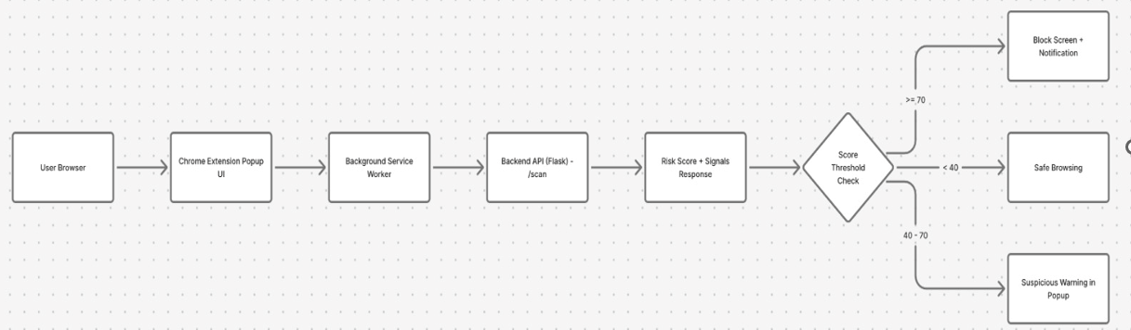
NEXATHON’25
Block diagram:
6

Slide 9
NEXATHON’25
FEATURES:
Real-time scanning of URLs and attachments whenever the user clicks or downloads.
Browser-integrated alerts that show clear Low / Medium / High risk warnings.
Central dashboard to view threat logs, timestamps, and basic statistics.
Support for multiple link formats (shortened URLs, redirects) and common file types.
Simple, guided warning messages to help non-technical users understand why something is risky.
6

Slide 10
NEXATHON’25
FUTURE ENHANCEMENT:
Future enhancements will focus on improving scalability so the analyzer can handle more users and traffic smoothly.
New detection features, such as smarter phishing and malware checks, will be added.
Integrations with more browsers, email platforms, and devices will be included.
These upgrades aim to improve user experience with clearer alerts and an easier dashboard.
They also aim to boost efficiency and overall detection performance.
8

Slide 11
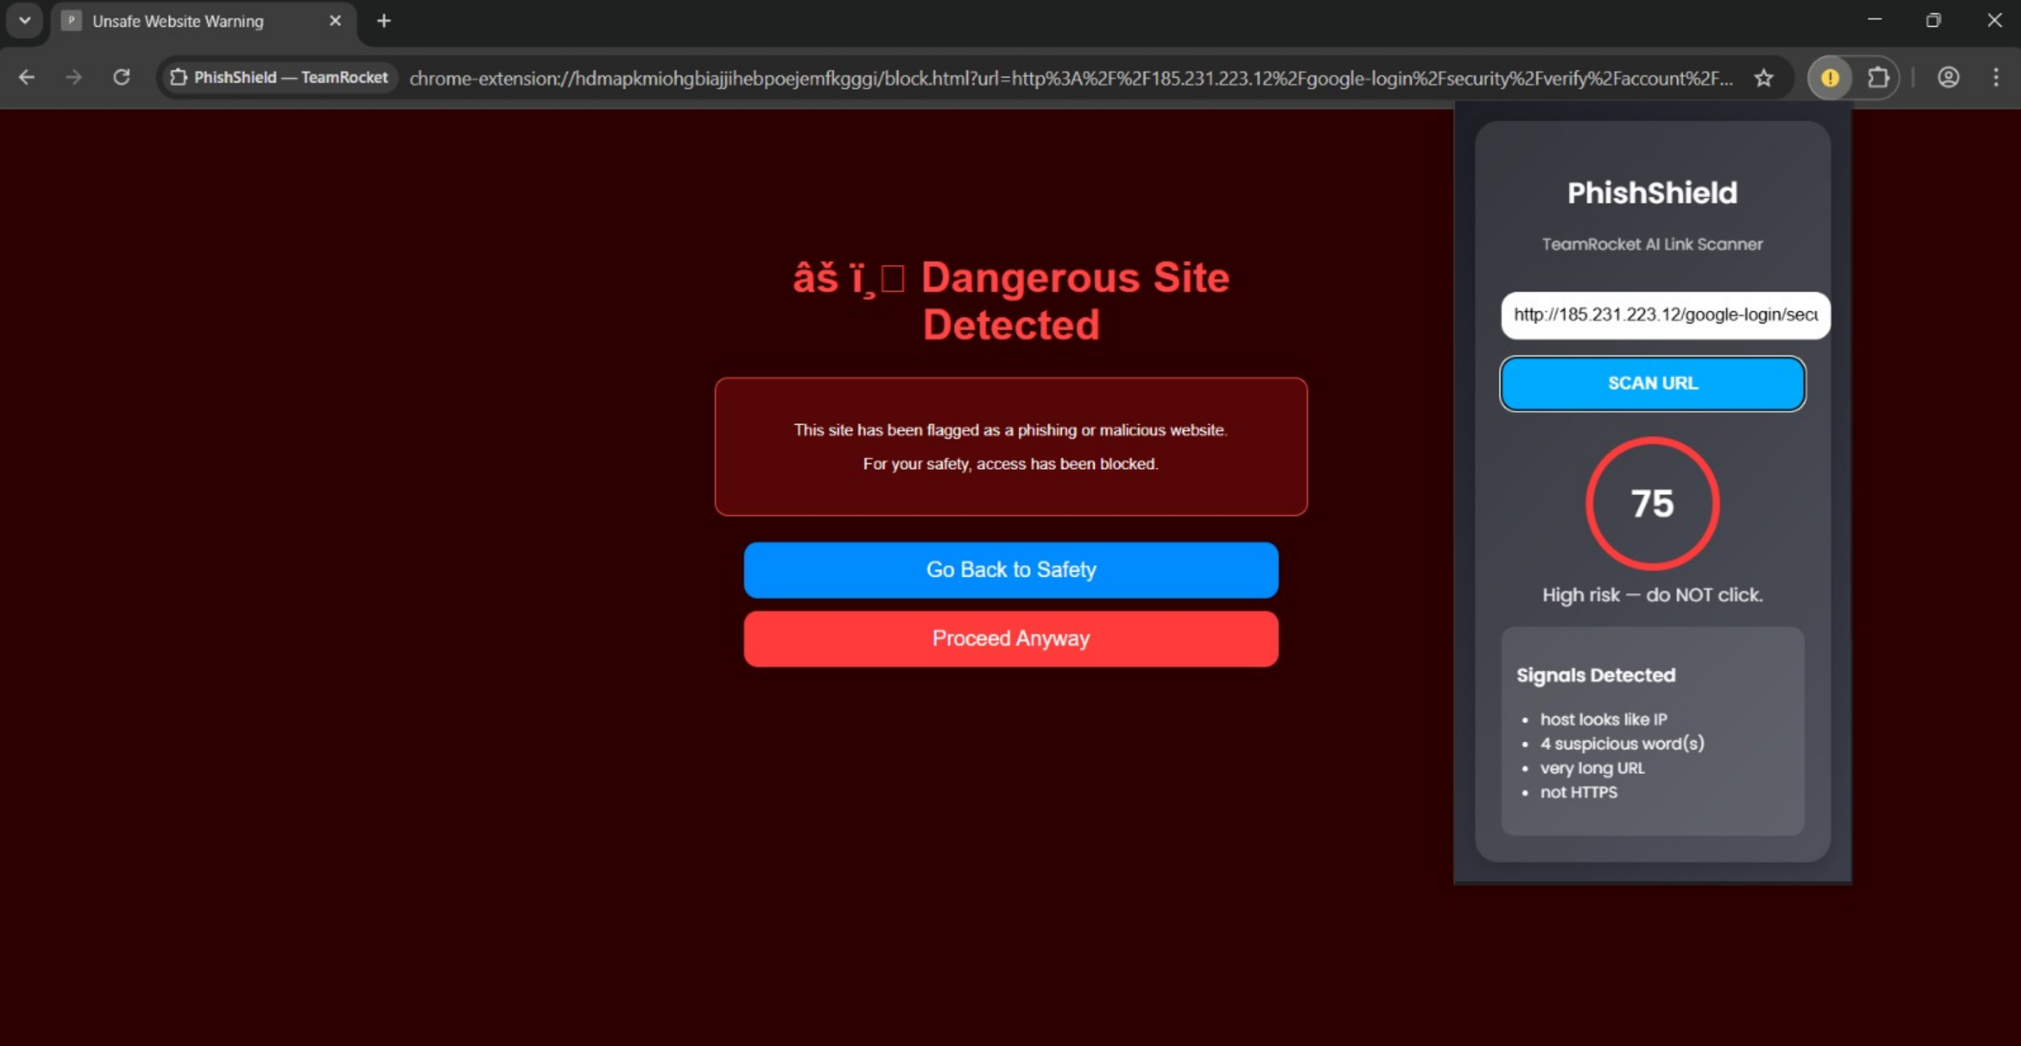
NEXATHON’25
RESULT:
The Advanced Phishing & Malware Link Analyzer successfully provides real-time protection within the browser by accurately detecting and flagging risky links and attachments with Low, Medium, or High threat scores all while maintaining a smooth browsing experience.
This system reduces user exposure to phishing and malware attacks, enhances awareness through clear alerts and a detailed threat dashboard, and establishes a scalable foundation for integrating more advanced models and features in the future.
Example:
8

